Slide 1

Prepared by group 4
Group Project
Financial Investment Product Recommender
19 November, 2024

Slide 2







Team Members
Gladys Mosota
Edwin Mbuthia
Annah Mukethe
Collins Ouko
Team Lead
Member
Member
Member
Petra Kibugu
Camilla Lumwaji
Eric Rono
Member
Member
Member
AM

Slide 3

Financial Investment Product Recommender System
This presentation outlines the development of an intelligent recommendation system for financial products, leveraging data-driven insights to transform investment decision-making and optimize customer journeys.
AM

Slide 4
PRESENTATION AGENDA
Introduction
Business Understanding
Problem statement
Insights and Modeling
Data Insights
Solution Overview
Next Steps
Success Metrics
Conclusion
Strategic Objectives
Domain Coverage
Models Employed
Customer Journey
Solution Impact
Next steps

Slide 5

Business Understanding
The financial landscape is constantly evolving, demanding intelligent solutions to guide investors. Our recommendation system is designed to address the ever-growing need for personalized and data-driven investment advice.
Purpose
Scope
To create a recommender system that recommends financial products tailored to individual investor profiles.
To enhance the entire customer journey, from initial onboarding to portfolio management and long-term investment strategy.
Focus
Target Audience
To deliver personalized recommendations based on individual risk tolerance, investment goals, and financial circumstances.
New investors seeking guidance
Existing customers exploring options
Financial advisors and planners

Slide 6
Problem Statement
Investors face a multitude of challenges in today's complex financial landscape. Our system aims to simplify investment decisions and provide tailored guidance.
Current Challenges
Business Impact
Complex investment landscape
Missed revenue opportunities
Limited personalization in product recommendations
Lower conversion rates
Inefficient cross-selling and upselling processes
Reduced customer satisfaction
Suboptimal customer onboarding experience
Limited portfolio diversification

Slide 7
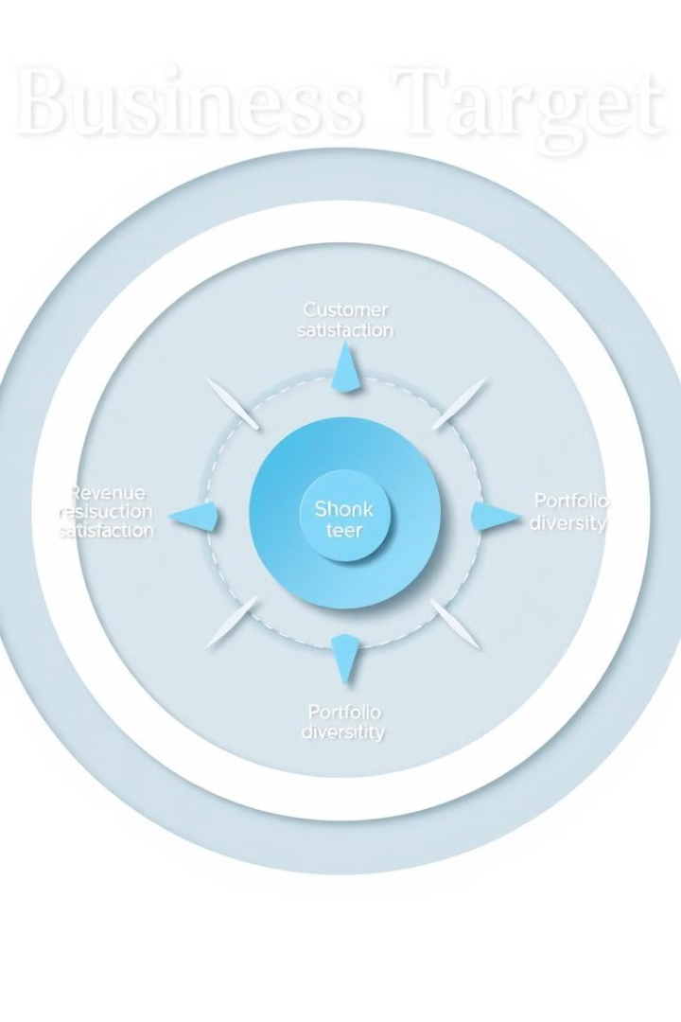
Strategic Objectives
The system aims to achieve a multitude of strategic objectives, driving revenue growth, customer acquisition, and long-term customer value.
Revenue Growth
1
The system is designed to enhance cross-selling success, boost product penetration, and improve upselling opportunities, leading to significant revenue growth.
2
Customer Acquisition
The system streamlines onboarding, improves conversion rates, and enhances the overall customer experience, attracting new customers and building a loyal base.
3
Lifetime Value Maximization
By fostering portfolio diversification, strengthening customer relationships, and building trust, the system aims to maximize customer lifetime value.

Slide 8

Domain Coverage
The system covers a comprehensive range of financial products, catering to diverse investor profiles and financial needs. It analyzes risk, goals, and time horizons to provide tailored recommendations.
Investment Products
Key Features
Bonds and fixed-income securities
Stable income, low risk
Money market funds
High liquidity, short-term investment
Equity funds
Potential for high returns, higher risk
Balanced funds
Diversification, moderate risk
Wealth management solutions
Personalized financial planning, comprehensive services
Sacco Products low risk, accessible loans

Slide 9
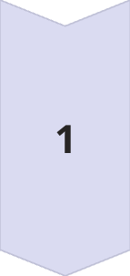

Data Insights
By analyzing vast amounts of customer data, we have gained valuable insights into investment preferences and behavior patterns.
Portfolio Analysis
Data analysis reveals distinct product preferences across different demographic groups. Wealth funds are particularly popular among investors aged 55 and above, while fixed-income securities attract younger professionals. Balanced funds appeal to middle-aged investors seeking a balanced approach, and money market funds are widely adopted across age groups.
Customer Behavior Insights
Our analysis highlights key patterns in customer behavior. Age significantly influences product preferences, with distinct trends observed across different age cohorts. Geographic location also plays a role, influencing investment choices based on local market conditions. Risk tolerance varies widely, with some investors favoring low-risk investments while others seek higher returns. Gender also affects product affinity, with different investment preferences often observed between male and female investors.

Slide 10
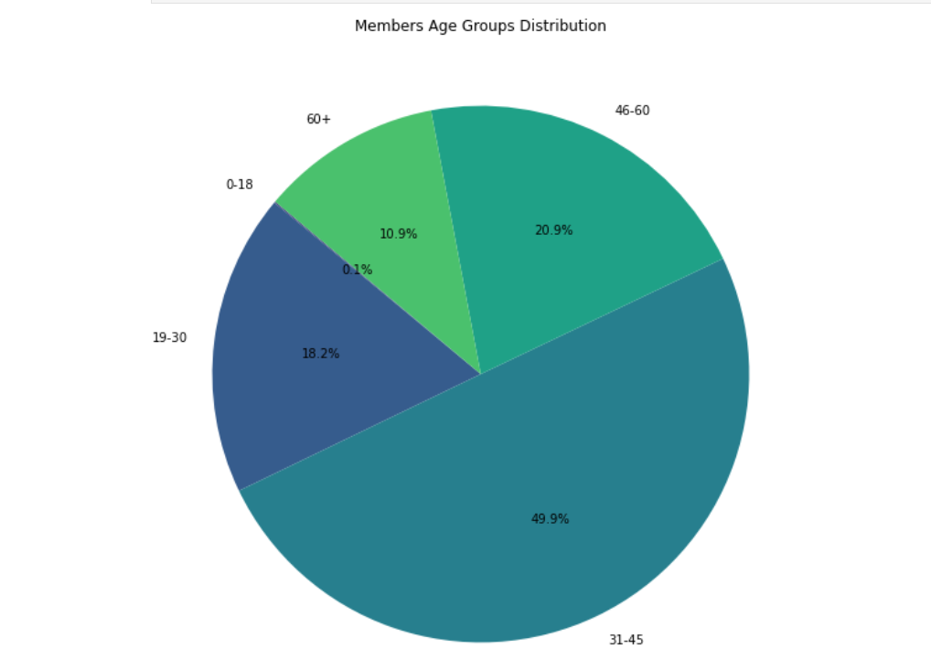
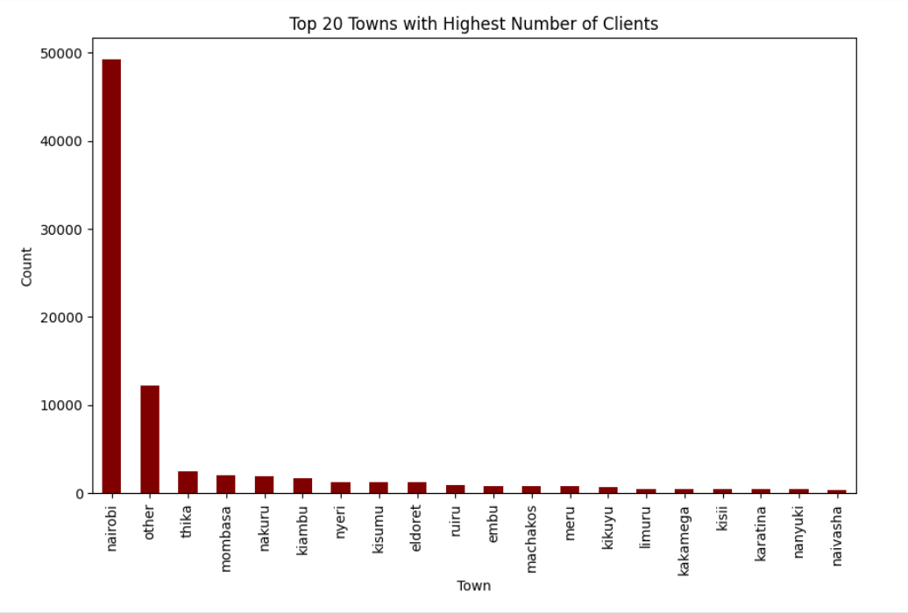
Age and Town Customer Distributions
Town Distribution
Age Distributions
Analyzing investor distribution by town helps identify regional preferences and tailor product offerings accordingly, optimizing geographic targeting.
We analyze the age distribution of investors and beneficiaries to understand demographic trends, potentially influencing product recommendations.

Slide 11
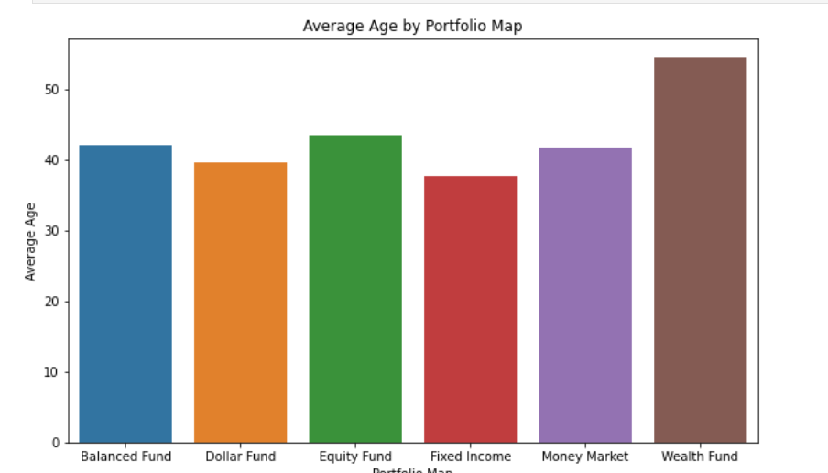
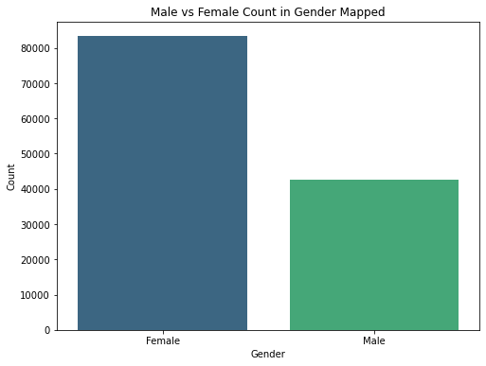
Gender and Products Distributions
Investment Product Preferences
Gender Distributions
We observe that we have more female customers than male customers , a clear indication that the demographics have impact on the product purchases or preferences
We investigate the most popular products by age group, revealing patterns in investment behavior that can guide cross-selling and upselling strategies.

Slide 12
Solution Overview
The core of our solution is a powerful recommendation engine that analyzes customer data and market trends to deliver tailored financial advice.
1
Core Capabilities
2
How It Works
For new customers, the system guides them through a structured onboarding process, assessing their risk tolerance, identifying financial goals, and recommending suitable investment products. For existing customers, the system analyzes their portfolios, tracks performance, identifies cross-selling opportunities, and suggests portfolio optimization strategies.
The engine leverages advanced algorithms to provide personalized product matching, risk profile assessment, goal-based recommendations, portfolio optimization, and cross-selling suggestions.

Slide 13

Models Employed
K-Nearest Neighbors(KNN)
Rule-Based Logic
Leveraged user preferences and past investment decisions to make personalized recommendations.
Analyzed product attributes and investor profiles to identify the most suitable investment options.
Hybrid Approach
Combined KNN and Rule-Based techniques to come up with a a more comprehensive recommendation system.

Slide 14
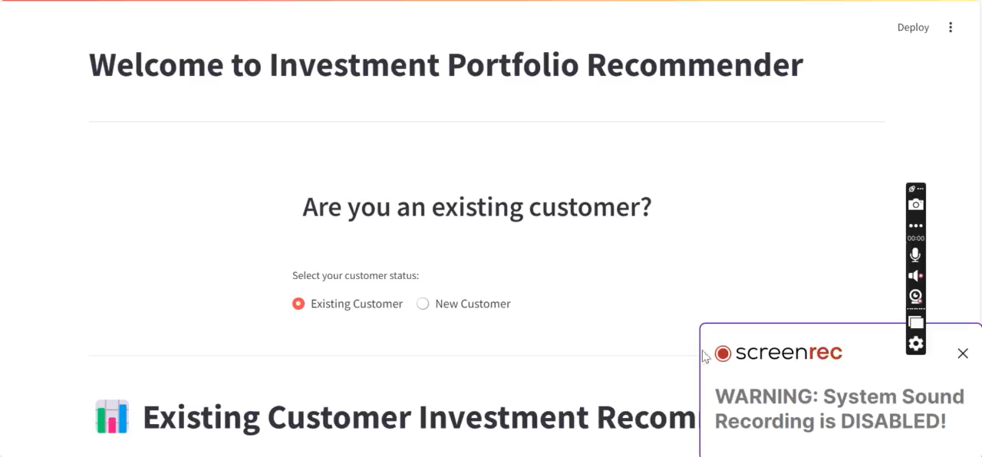
Deployed Solution

Slide 15
CUSTOMER JOURNEY
Customer satisfaction and portfolio expansion
Over time, John adds more products based on the app's recommendations.
06
Investment
05
Monitor’s Portfolio Performance
04
John follows the tailored advice and diversifies his investments.
The app provides ongoing tracking and optimization suggestions
Risk Assessment and Personalized recommendations
CUSTOMER
Visits Investment App
03
01
John explores the app,
seeking guidance on
investment options.
02
Meet John. 35 years old
Nairobi resident, looking to diversify investments.
The app analyzes John's risk profile and financial goals. The system suggests a balanced portfolio of funds aligned with John's needs.

Slide 16
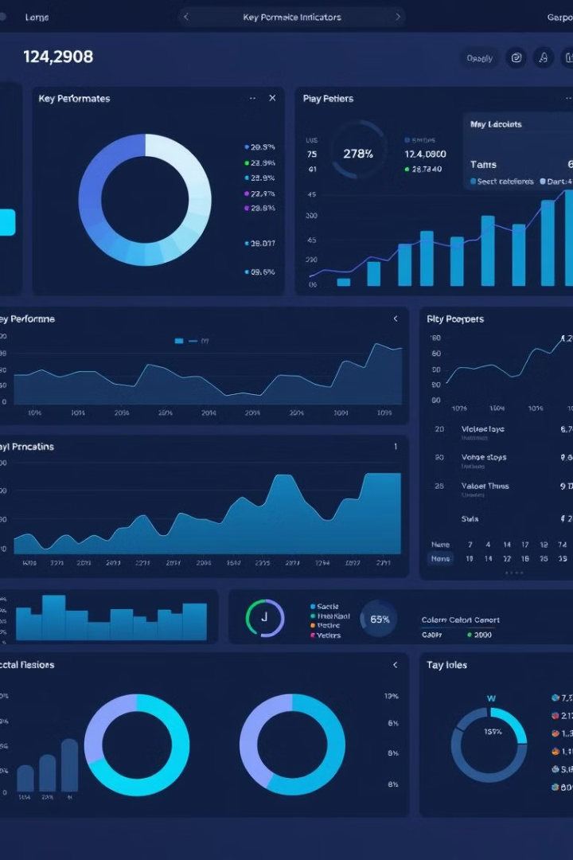




Success Metrics
The success of the recommendation system will be measured by key performance indicators that track its impact on business outcomes and customer satisfaction.
Recommendation Accuracy
Customer Adoption Rates
The system's ability to provide accurate and relevant product recommendations based on individual investor profiles.
The percentage of customers who adopt the system's recommended investment products.
Portfolio Diversification
Revenue Impact
The extent to which the system helps customers diversify their investment portfolios.
The financial impact of the system on revenue growth and profitability.

Slide 17

The solution Impact: Empowering Customers, Driving Growth
1
Customer Satisfaction
By providing personalized and relevant investment options, we enhance customer satisfaction, fostering loyalty and trust.
2
Enhanced Retention
Customers who feel understood and valued are more likely to stay with us, leading to increased customer retention and loyalty.
3
Revenue Growth
Cross-selling opportunities arise as customers explore additional investment options tailored to their needs, leading to increased revenue and profitability.

Slide 18
Next Steps: A Vision for Innovation
Incorporate Additional Data- Expand the dataset to include income level,
risk tolerance, and investment goals for enhanced personalization.
1
Test Alternative Algorithms- Experiment with different algorithms like
collaborative filtering or deep learning techniques for improved
accuracy.
2
Fine-tune Rules-Continuously refine the rule-based
system to better match individual investor needs .
3
4
Personalized Portfolio Management: Personalize products as
per the customer Profiles.

Slide 19

A Brighter Future for Investment
This personalized recommendation system represents a significant step forward in our commitment to delivering exceptional investment experiences. We are excited to see how it empowers customers, enhances our business, and shapes the future of financial services.

Slide 20


Thank you

